Slide 1
Entanglement and its Verification NYC Quantum Meetup 9/19/2017
Or How I learned to Stop Worrying and love NON-Local Theories
Muir Kumph
IBM Research 2017

Slide 2
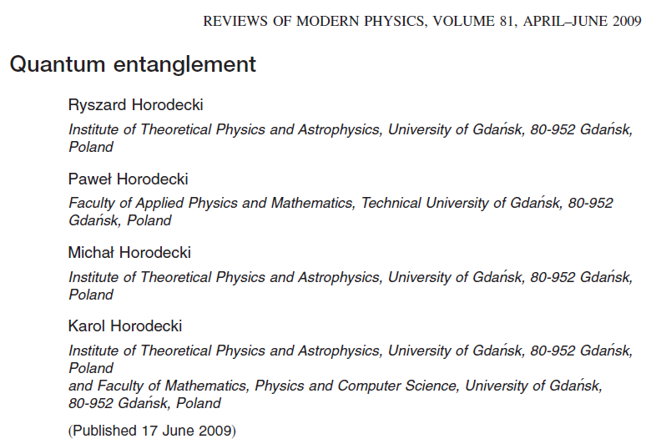
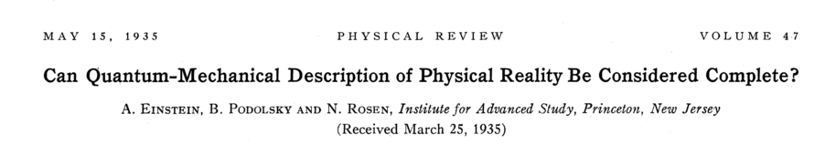
Entanglement is the ‘Magic’ of Quantum Mechanics
there is no end of weird and ‘new age’ descriptions
all particles in the universe are connected
spooky action at a distance (Einstein)
seems to be needed for exponential speed-up
today we do it with math
for a thorough review – see Horodecki et. al

Slide 3
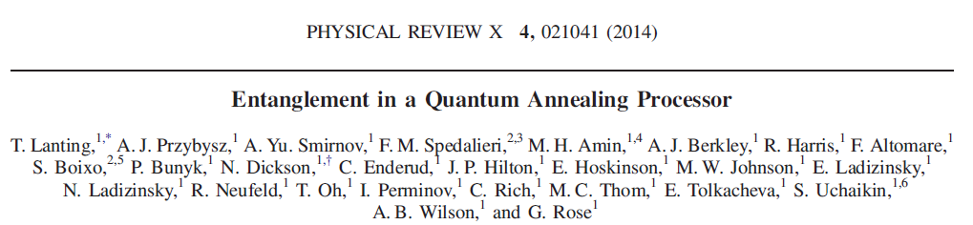
Entanglement Verification is Important
entanglement is necessary (but not sufficient) for an exponential speed-up
otherwise, the machine cannot be what I would call a ‘Quantum Computer’
eg. D-wave
at best it looks like D-Wave built an 8 qubit quantum annealer
thousand of qubits are just bits if no entanglement can be demonstrated
when companies claim large numbers of qubits, check to see if they are entangled

Slide 4
What does it mean?
entangled states can have the property of non-locality
measuring one part of a system of entangled particles has an effect on the other particles
3 qubit system is the simplest system to demonstrate this without resorting to statistics – just need a few measurements

Slide 5
Outline Today
all the quantum theory necessary to understand 3 qubit entanglement
introduction to probability
2 qubit Bell/CHSH Inequalities

Slide 6
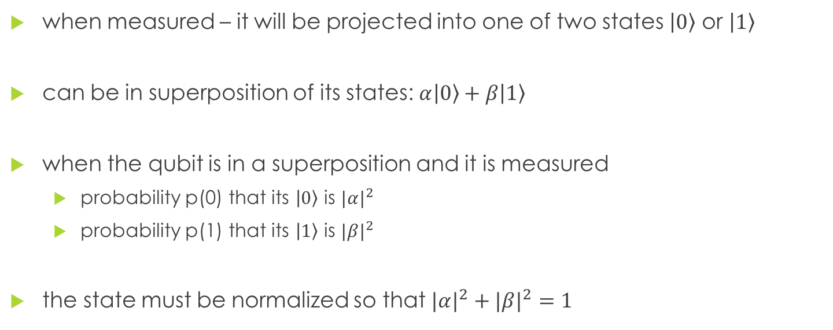
Fundamental Quantum State - Qubit
when measured – it will be projected into one of two states $\left|0\right\rangle$ or $|1〉$
can be in superposition of its states: $α\left|0\right\rangle +β|1〉$
when the qubit is in a superposition and it is measured
probability p(0) that its $\left|0\right\rangle$ is ${|α|}^{2}$
probability p(1) that its $\left|1\right\rangle$ is ${|β|}^{2}$
the state must be normalized so that ${|α|}^{2}+{|β|}^{2}=1$

Slide 7

bras and kets
kets
$\left|0\right\rangle =\left(\begin{matrix}1 \\ 0\end{matrix}\right)$
$|1〉=$ $\left(\begin{matrix}0 \\ 1\end{matrix}\right)$
bras
$\left\langle 0\right|= \left(\begin{matrix}1 & 0\end{matrix}\right)$
$\left\langle 1\right|= \left(\begin{matrix}0 & 1\end{matrix}\right)$
brakets
$\left\langle 0 | 0\right\rangle =1$
$\left\langle 1 | 1\right\rangle =1$
$\left\langle 0 | 1\right\rangle =0$
$\left\langle 1 | 0\right\rangle =0$

Slide 8
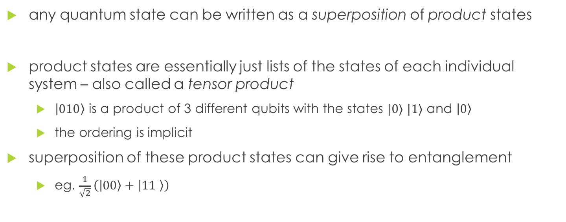
Multiqubit States
any quantum state can be written as a superposition of product states
product states are essentially just lists of the states of each individual system – also called a tensor product
$|010〉$ is a product of 3 different qubits with the states $|0⟩$ $|1⟩$ and $\left|0\right\rangle$
the ordering is implicit
superposition of these product states can give rise to entanglement
eg. $\frac{1}{\sqrt{2}}\left(\left|00\right\rangle +\left|11 \right\rangle \right)$

Slide 9
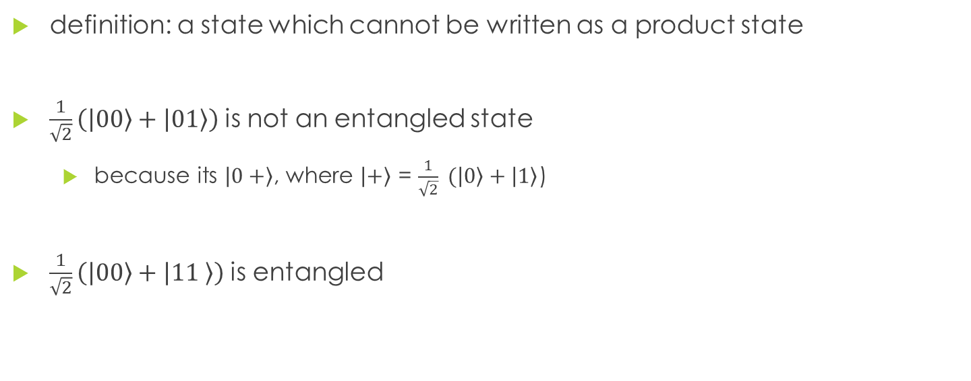
Entanglement
definition: a state which cannot be written as a product state
$\frac{1}{\sqrt{2}}\left(\left|00\right\rangle +\left|01\right\rangle \right)$ is not an entangled state
because its $\left|0+\right\rangle$, where $\left|+\right\rangle$ = $\frac{1}{\sqrt{2}} (\left|0\right\rangle +\left|1\right\rangle$)
$\frac{1}{\sqrt{2}}\left(\left|00\right\rangle +\left|11 \right\rangle \right)$ is entangled

Slide 10
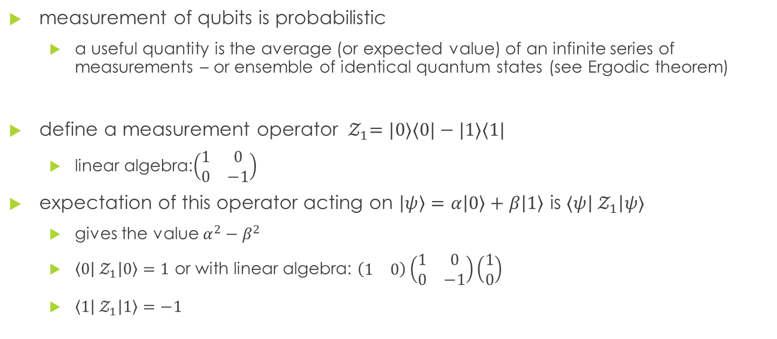
Expectation Values
measurement of qubits is probabilistic
a useful quantity is the average (or expected value) of an infinite series of measurements – or ensemble of identical quantum states (see Ergodic theorem)
define a measurement operator ${ 𝒵}_{1}=|0〉〈0|−|1〉〈1|$
linear algebra:$\left(\begin{matrix}1 & 0 \\ 0 & −1\end{matrix}\right)$
expectation of this operator acting on $\left|ψ\right\rangle =α\left|0\right\rangle +β|1〉$ is $⟨ψ\left|{ 𝒵}_{1}\right|ψ⟩$
gives the value $α^{2}−β^{2}$
$\left\langle 0\left|{ 𝒵}_{1}\right|0\right\rangle =1$ or with linear algebra: $\left(\begin{matrix}1 & 0\end{matrix}\right)\left(\begin{matrix}1 & 0 \\ 0 & −1\end{matrix}\right)\left(\begin{matrix}1 \\ 0\end{matrix}\right)$
$\left\langle 1\left|{ 𝒵}_{1}\right|1\right\rangle =−1$

Slide 11

Pop Quiz
${ 𝒵}_{1}=|0〉〈0|−|1〉〈1|$
$\left|+\right\rangle$ = $\frac{1}{\sqrt{2}} (\left|0\right\rangle +\left|1\right\rangle$)
what is $⟨+\left|{ 𝒵}_{1}\right|+⟩$?
remember to keep order of bras and kets!
$\left\langle +\right|(|0〉〈0|−|1〉〈1|)\left|+\right\rangle$
$\frac{1}{\sqrt{2}}(\left\langle 0\right|+⟨1|)(|0〉〈0|−|1〉〈1|) \frac{1}{\sqrt{2}} (\left|0\right\rangle +\left|1\right\rangle$)

Slide 12
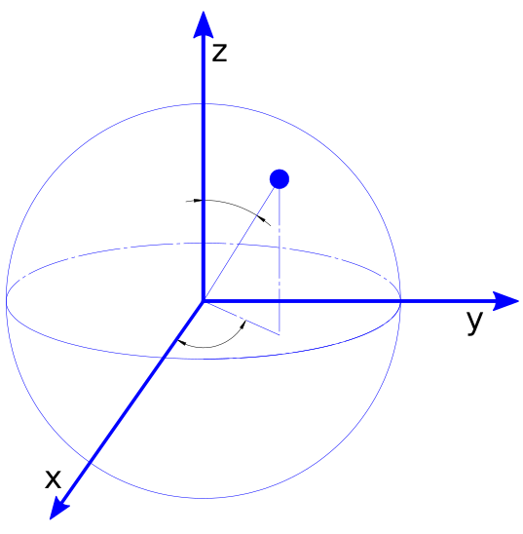


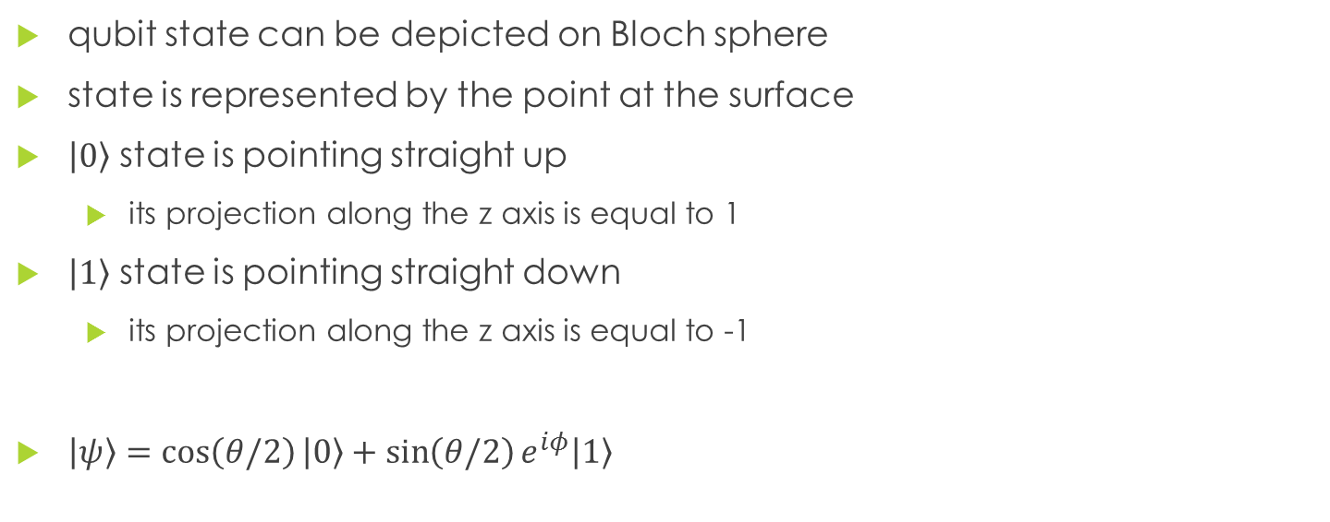
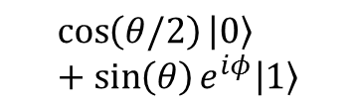



Bloch Sphere
$$\left|0\right\rangle$$
qubit state can be depicted on Bloch sphere
state is represented by the point at the surface
$\left|0\right\rangle$ state is pointing straight up
its projection along the z axis is equal to 1
$\left|1\right\rangle$ state is pointing straight down
its projection along the z axis is equal to -1
$\left|ψ\right\rangle =\cos\left(θ/2\right)\left|0\right\rangle +\sin\left(θ/2\right)e^{iφ}|1〉$
$$\cos\left(θ/2\right)\left|0\right\rangle +\sin\left(θ\right)e^{iφ}|1〉$$
$$θ$$
$$φ$$
$\frac{1}{\sqrt{2}} (\left|0\right\rangle +\left|1\right\rangle$)
$$\left|1\right\rangle$$

Slide 13

3 Qubit System
GHZ (Greenberger-Horne-Zeilinger) state: $\frac{|000〉−|111〉}{\sqrt{2}}$
Or if you prefer linear algebra:$\left(\begin{aligned}\frac{1}{\sqrt{2}} \\ 0 \\ 0 \\ 0 \\ 0 \\ 0 \\ 0 \\ −\frac{1}{\sqrt{2}}\end{aligned}\right)$

Slide 14
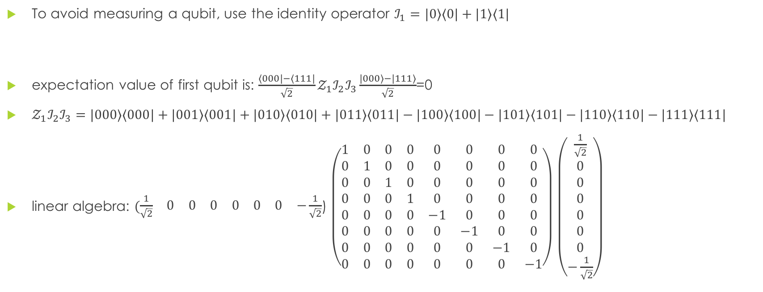
Expectation of Single Qubit in GHZ
To avoid measuring a qubit, use the identity operator $ℐ_{1}$ $=|0〉〈0|+|1〉〈1|$
expectation value of first qubit is: $\frac{〈000|−〈111|}{\sqrt{2}}𝒵_{1}ℐ_{2}ℐ_{3}\frac{|000〉−|111〉}{\sqrt{2}}$=0
$𝒵_{1}ℐ_{2}ℐ_{3}=|000〉〈000|+|001〉〈001|+|010〉〈010|+|011〉〈011|−|100〉〈100|−|101〉〈101|−|110〉〈110|−|111〉〈111|$
linear algebra: $(\begin{matrix}\frac{1}{\sqrt{2}} & 0 & 0 & 0 & 0 & 0 & 0 & −\frac{1}{\sqrt{2}}\end{matrix}$) $\left(\begin{matrix}1 & 0 & 0 & 0 & 0 & 0 & 0 & 0 \\ 0 & 1 & 0 & 0 & 0 & 0 & 0 & 0 \\ 0 & 0 & 1 & 0 & 0 & 0 & 0 & 0 \\ 0 & 0 & 0 & 1 & 0 & 0 & 0 & 0 \\ 0 & 0 & 0 & 0 & −1 & 0 & 0 & 0 \\ 0 & 0 & 0 & 0 & 0 & −1 & 0 & 0 \\ 0 & 0 & 0 & 0 & 0 & 0 & −1 & 0 \\ 0 & 0 & 0 & 0 & 0 & 0 & 0 & −1\end{matrix}\right)$ $\left(\begin{aligned}\frac{1}{\sqrt{2}} \\ 0 \\ 0 \\ 0 \\ 0 \\ 0 \\ 0 \\ −\frac{1}{\sqrt{2}}\end{aligned}\right)$

Slide 15

Pop Quiz
compute the expectation value of first qubit: $\frac{〈000|−〈111|}{\sqrt{2}}𝒵_{1}ℐ_{2}ℐ_{3}\frac{|000〉−|111〉}{\sqrt{2}}$=0
$𝒵_{1}ℐ_{2}ℐ_{3}=|000〉〈000|+|001〉〈001|+|010〉〈010|+|011〉〈011|−|100〉〈100|−|101〉〈101|−|110〉〈110|−|111〉〈111|$

Slide 16

Expectation Values of Parity Measurement
Multiply operators together: $𝒵_{1}𝒵_{2}𝒵_{3}$
linear algebra (Tensor Product) $\left(\begin{matrix}1 & 0 & 0 & 0 & 0 & 0 & 0 & 0 \\ 0 & −1 & 0 & 0 & 0 & 0 & 0 & 0 \\ 0 & 0 & −1 & 0 & 0 & 0 & 0 & 0 \\ 0 & 0 & 0 & 1 & 0 & 0 & 0 & 0 \\ 0 & 0 & 0 & 0 & −1 & 0 & 0 & 0 \\ 0 & 0 & 0 & 0 & 0 & 1 & 0 & 0 \\ 0 & 0 & 0 & 0 & 0 & 0 & 1 & 0 \\ 0 & 0 & 0 & 0 & 0 & 0 & 0 & −1\end{matrix}\right)$

Slide 17
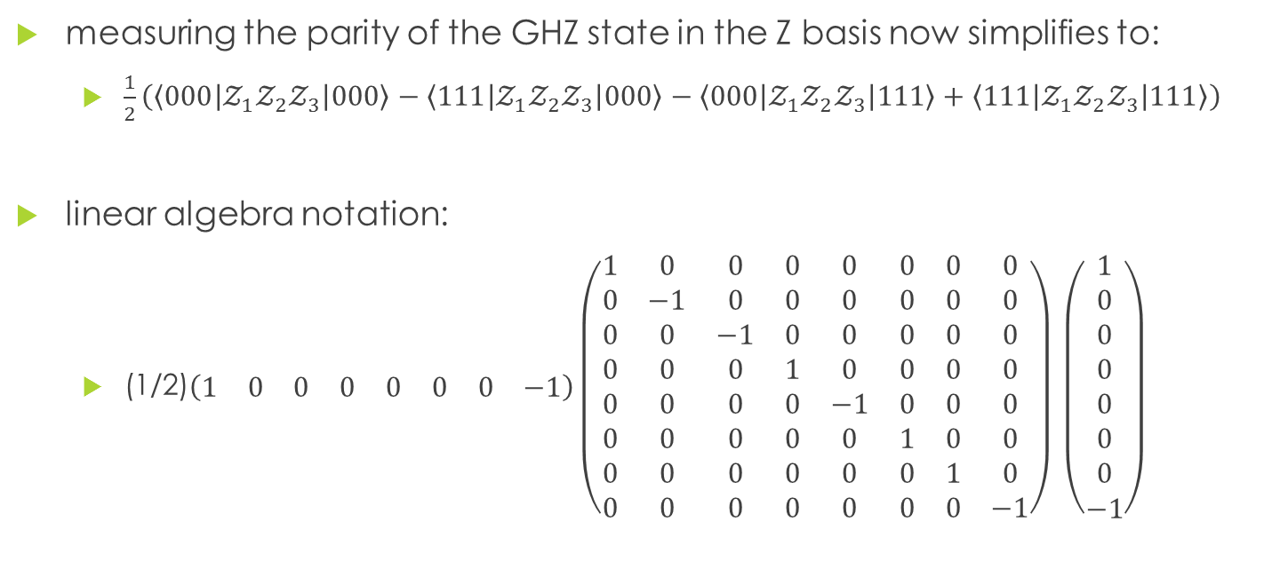
Parity or Combined Expectations
measuring the parity of the GHZ state in the Z basis now simplifies to:
$\frac{1}{2}\left(〈000\left|𝒵_{1}𝒵_{2}𝒵_{3}\right|000〉−〈111\left|𝒵_{1}𝒵_{2}𝒵_{3}\right|000〉−〈000\left|𝒵_{1}𝒵_{2}𝒵_{3}\right|111〉+〈111\left|𝒵_{1}𝒵_{2}𝒵_{3}\right|111〉\right)$
linear algebra notation:
(1/2)$(\begin{matrix}1 & 0 & 0 & 0 & 0 & 0 & 0 & −1\end{matrix})\left(\begin{matrix}1 & 0 & 0 & 0 & 0 & 0 & 0 & 0 \\ 0 & −1 & 0 & 0 & 0 & 0 & 0 & 0 \\ 0 & 0 & −1 & 0 & 0 & 0 & 0 & 0 \\ 0 & 0 & 0 & 1 & 0 & 0 & 0 & 0 \\ 0 & 0 & 0 & 0 & −1 & 0 & 0 & 0 \\ 0 & 0 & 0 & 0 & 0 & 1 & 0 & 0 \\ 0 & 0 & 0 & 0 & 0 & 0 & 1 & 0 \\ 0 & 0 & 0 & 0 & 0 & 0 & 0 & −1\end{matrix}\right)$ $\left(\begin{aligned}1 \\ 0 \\ 0 \\ 0 \\ 0 \\ 0 \\ 0 \\ −1\end{aligned}\right)$

Slide 18



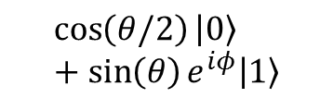



Measuring in Other Basis
$\left|+\right\rangle$ = $\frac{1}{\sqrt{2}} (\left|0\right\rangle +\left|1\right\rangle$)
we can measure in the + basis (also called the $𝒳_{1}$ basis)
$𝒳_{}$ $=|1〉〈0|+|0〉〈1|$
$𝒴_{}=ⅈ|1〉〈0|−ⅈ|0〉〈1|$
$$\left|0\right\rangle$$
$$\cos\left(θ/2\right)\left|0\right\rangle +\sin\left(θ\right)e^{iφ}|1〉$$
$$θ$$
$$φ$$
$\frac{1}{\sqrt{2}} (\left|0\right\rangle +\left|1\right\rangle$)
$$\left|1\right\rangle$$

Slide 19
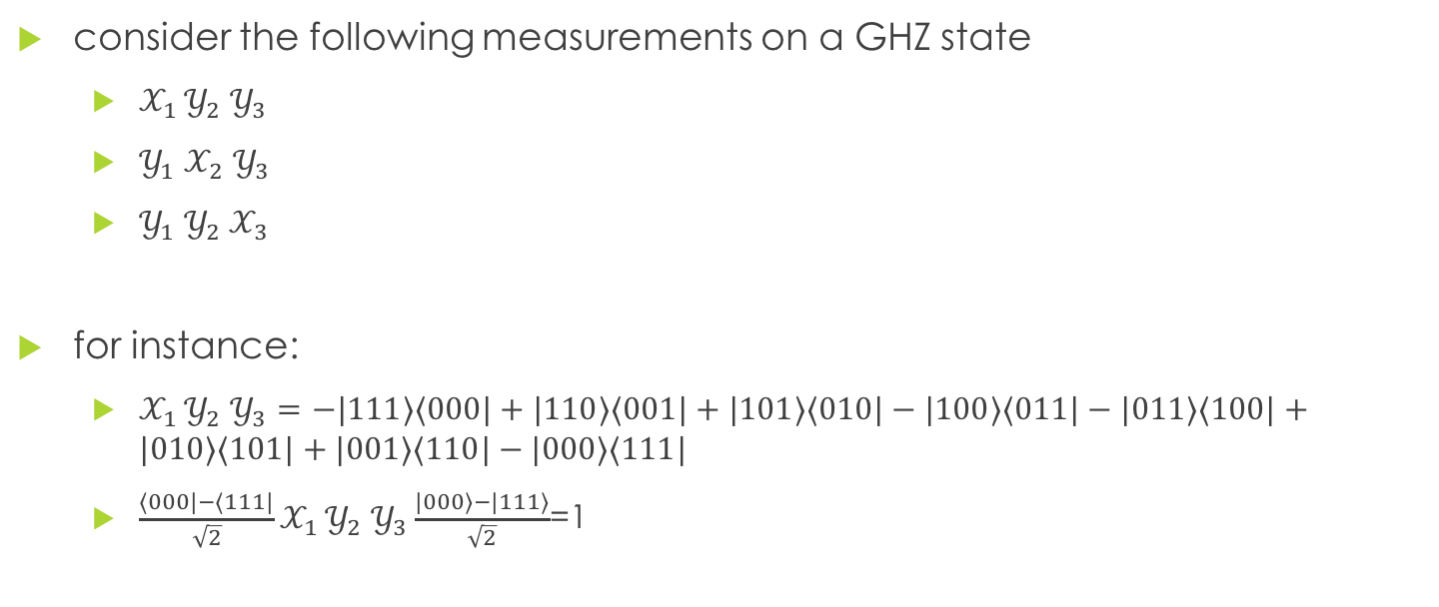
Parity Measurements of the GHZ State
consider the following measurements on a GHZ state
$𝒳_{1 }𝒴_{2} 𝒴_{3}$
$𝒴_{1} 𝒳_{2}$ $𝒴_{3}$
$𝒴_{1} 𝒴_{2} 𝒳_{3}$
for instance:
$𝒳_{1 }𝒴_{2} 𝒴_{3}=−|111〉〈000|+|110〉〈001|+|101〉〈010|−|100〉〈011|−|011〉〈100|+|010〉〈101|+|001〉〈110|−|000〉〈111|$
$\frac{〈000|−〈111|}{\sqrt{2}}𝒳_{1 }𝒴_{2} 𝒴_{3}\frac{|000〉−|111〉}{\sqrt{2}}$=1

Slide 20
Local Hidden Variable Theories
imagine there are three people who are given different colored balls, say red green and blue
without looking at the balls are put into their pockets and they walk far away from each other
there is an unknown assignment of the colored balls and the people (reality)
if you ask one person to take out a ball and tell you the color, then the colors of the other balls don’t change (local)
measuring in different basis could be thought of as asking different questions about the balls – like how big is it, or what is it made of?

Slide 21



Locality and Reality of Multi-qubit Systems
we are about to disprove this! Proof by contradiction
there should be some sort of hidden value which is revealed by measurement (reality)
the measurement of say qubit 1 should not change the hidden value of another qubit (locality)
$$𝒳_{1 }$$
$$𝒴_{2}$$
$$𝒴_{3}$$
1
2
3

Slide 22
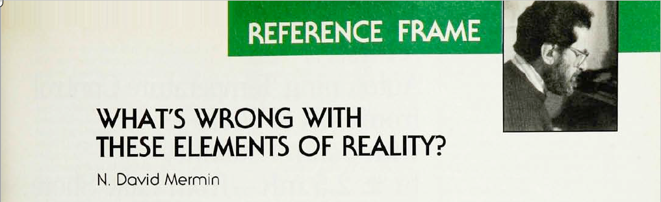
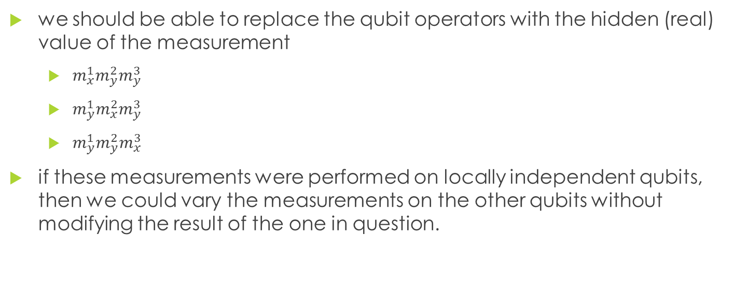
Local and Real Qubits
we should be able to replace the qubit operators with the hidden (real) value of the measurement
$m_{x}^{1}m_{y}^{2}m_{y}^{3}$
$m_{y}^{1}m_{x}^{2}m_{y}^{3}$
$m_{y}^{1}m_{y}^{2}m_{x}^{3}$
if these measurements were performed on locally independent qubits, then we could vary the measurements on the other qubits without modifying the result of the one in question.
Mermin, N. D. (1990). What’s wrong with these elements of reality? Physics Today, 43(6), 9–11. https://doi.org/10.1063/1.2810588

Slide 23
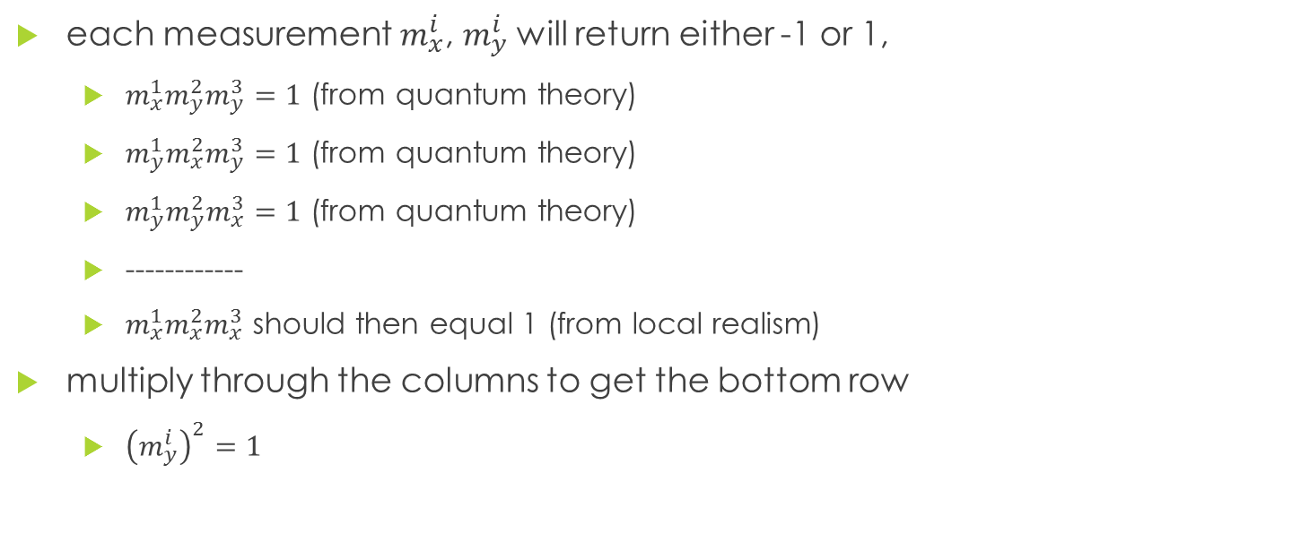
Parity Measurements of Local Qubits
each measurement $m_{x}^{i}$, $m_{y}^{i}$will return either -1 or 1,
$m_{x}^{1}m_{y}^{2}m_{y}^{3}=1$ (from quantum theory)
$m_{y}^{1}m_{x}^{2}m_{y}^{3}=1$ (from quantum theory)
$m_{y}^{1}m_{y}^{2}m_{x}^{3}=1$ (from quantum theory)
------------
$m_{x}^{1}m_{x}^{2}m_{x}^{3}$ should then equal 1 (from local realism)
multiply through the columns to get the bottom row
${\left(m_{y}^{i}\right)}^{2}=1$

Slide 24
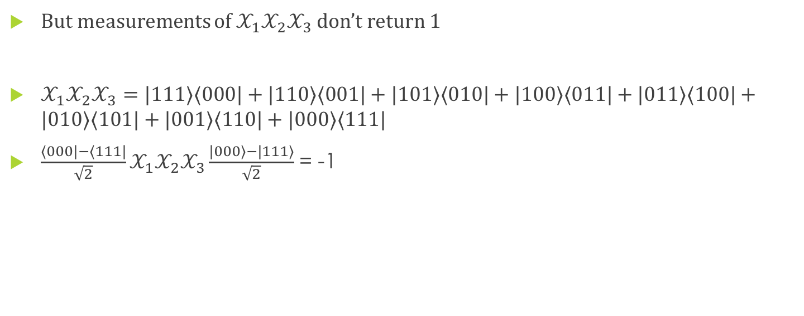
Parity Measurements of Local Qubits
But measurements of $𝒳_{1}𝒳_{2}𝒳_{3}$ don’t return 1
$𝒳_{1}𝒳_{2}𝒳_{3}=|111〉〈000|+|110〉〈001|+|101〉〈010|+|100〉〈011|+|011〉〈100|+|010〉〈101|+|001〉〈110|+|000〉〈111|$
$\frac{〈000|−〈111|}{\sqrt{2}}𝒳_{1}𝒳_{2}𝒳_{3}\frac{|000〉−|111〉}{\sqrt{2}}$ = -1

Slide 25

Pop Quiz
compute the expected value of the $𝒳_{1}𝒳_{2}𝒳_{3}$ measurement on the GHZ state
$𝒳_{1}𝒳_{2}𝒳_{3}=|111〉〈000|+|110〉〈001|+|101〉〈010|+|100〉〈011|+|011〉〈100|+|010〉〈101|+|001〉〈110|+|000〉〈111|$
$\frac{|000〉−|111〉}{\sqrt{2}}$

Slide 26
Reality or Locality?
quantum theory of a GHZ state along with the assumptions of reality and locality lead to a contradiction
quantum theory: seems to be right
reality: a cherished concept – that there is one common reality for us all – independent of observation made
locality: has to go
measurements on one part of a quantum system can change the other parts of the system.

Slide 27
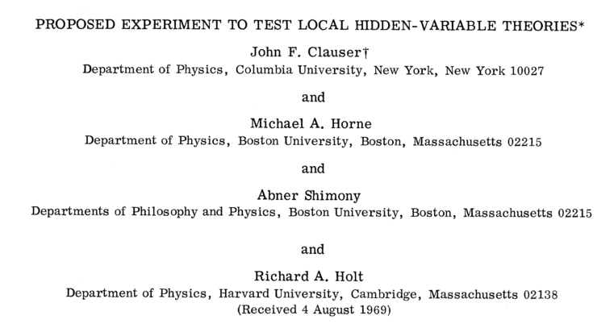
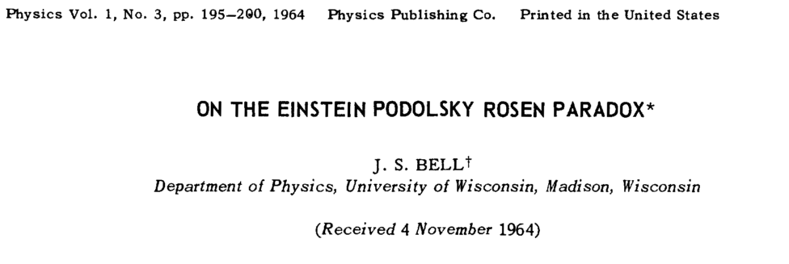
what about less than 3 qubits?
GHZ states can be hard to create
2 qubits are sufficient to demonstrate entanglement
Bell first notice this in 1969
Clauser, Horne, Shimony and Holt

Slide 28
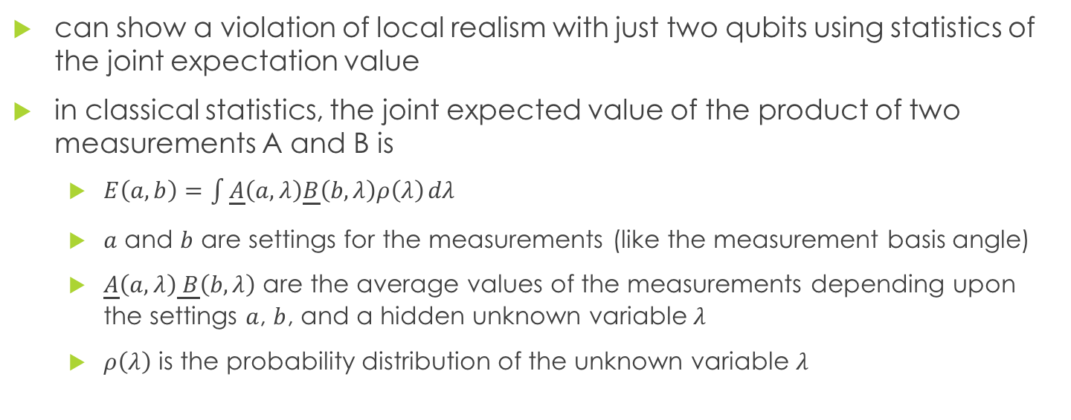
Bell/CHSH Inequalities
can show a violation of local realism with just two qubits using statistics of the joint expectation value
in classical statistics, the joint expected value of the product of two measurements A and B is
$E\left(a,b\right)=\int{\underline{A}\left(a,λ\right)\underline{B}\left(b,λ\right)ρ\left(λ\right)}dλ$
$a$ and $b$ are settings for the measurements (like the measurement basis angle)
$\underline{A}\left(a,λ\right)\underline{ B}\left(b,λ\right)$ are the average values of the measurements depending upon the settings $a$, $b$, and a hidden unknown variable $λ$
$ρ\left(λ\right)$ is the probability distribution of the unknown variable $λ$

Slide 29
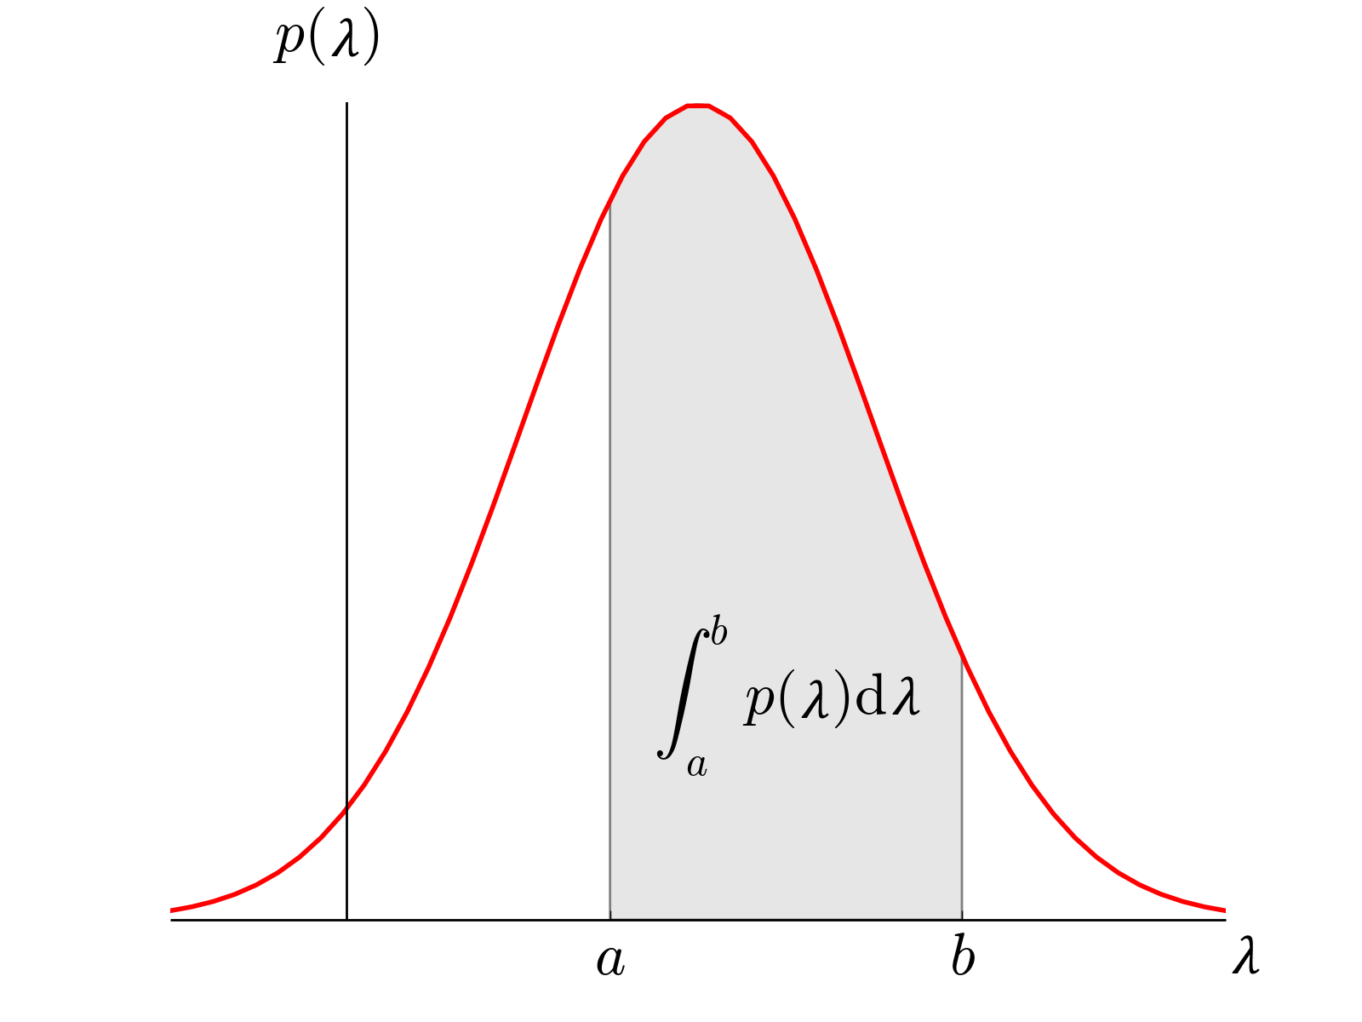

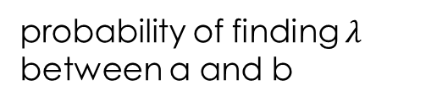
Probability Distribution Functions (PDF)
The probability of all possible values of the variable $λ$ must be 1
$\int{ρ\left(λ\right)}dλ=1$
probability of finding $λ$ between a and b

Slide 30
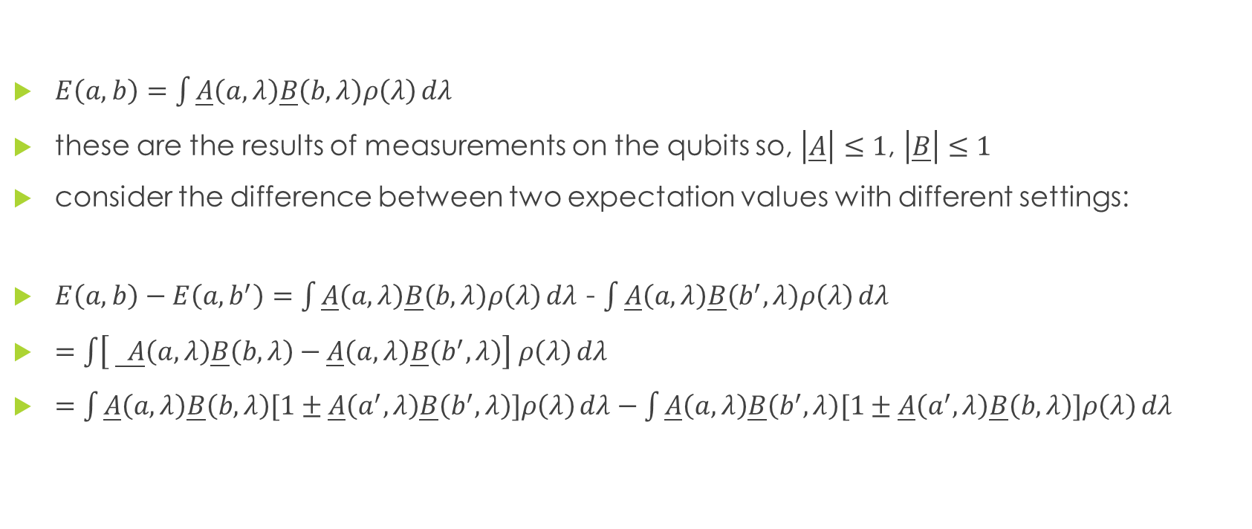
Joint Expectation Value
$E\left(a,b\right)=\int{\underline{A}\left(a,λ\right)\underline{B}\left(b,λ\right)ρ\left(λ\right)}dλ$
these are the results of measurements on the qubits so, $\left|\underline{A}\right|≤1$, $\left|\underline{B}\right|≤1$
consider the difference between two expectation values with different settings:
$E\left(a,b\right)−E\left(a,b^{′}\right)=$ $\int{\underline{A}\left(a,λ\right)\underline{B}\left(b,λ\right)ρ\left(λ\right)}dλ$ - $\int{\underline{A}\left(a,λ\right)\underline{B}\left(b^{′},λ\right)ρ\left(λ\right)}dλ$
$=$ $\int{\left[ \underline{ A}\left(a,λ\right)\underline{B}\left(b,λ\right)−\underline{A}\left(a,λ\right)\underline{B}\left(b^{′},λ\right)\right] ρ\left(λ\right)}dλ$
$=$ $\int{\underline{A}\left(a,λ\right)\underline{B}\left(b,λ\right)[1±\underline{A}\left(a^{′},λ\right)\underline{B}\left(b^{′},λ\right)]ρ\left(λ\right)}dλ−\int{\underline{A}\left(a,λ\right)\underline{B}\left(b^{′},λ\right)[1±\underline{A}\left(a^{′},λ\right)\underline{B}\left(b,λ\right)]ρ\left(λ\right)}dλ$

Slide 31
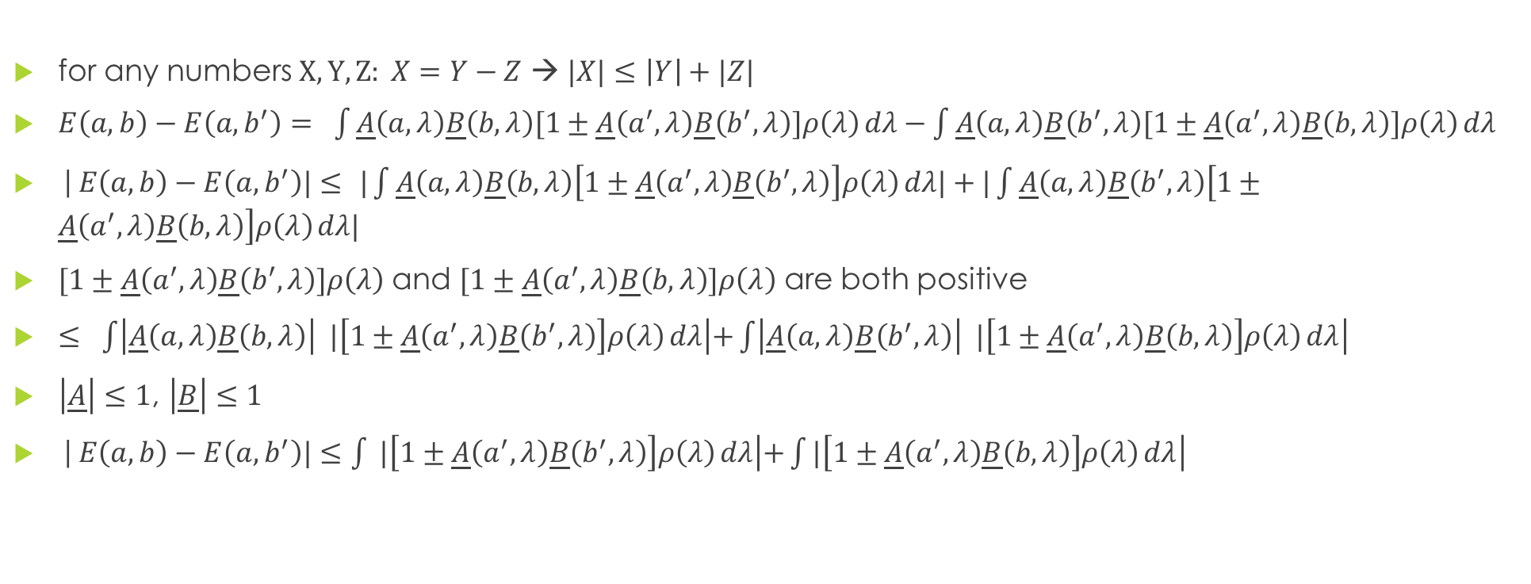
Joint Expectation Value
for any numbers $X, Y, Z: X=Y−Z$ → $|X|≤\left|Y\right|+|Z|$
$E\left(a,b\right)−E\left(a,b^{′}\right)= \int{\underline{A}\left(a,λ\right)\underline{B}\left(b,λ\right)[1±\underline{A}\left(a^{′},λ\right)\underline{B}\left(b^{′},λ\right)]ρ\left(λ\right)}dλ−\int{\underline{A}\left(a,λ\right)\underline{B}\left(b^{′},λ\right)[1±\underline{A}\left(a^{′},λ\right)\underline{B}\left(b,λ\right)]ρ\left(λ\right)}dλ$
|$E\left(a,b\right)−E\left(a,b^{′}\right)|≤ |\int{\underline{A}\left(a,λ\right)\underline{B}\left(b,λ\right)\left[1±\underline{A}\left(a^{′},λ\right)\underline{B}\left(b^{′},λ\right)\right]ρ\left(λ\right)}dλ|+|\int{\underline{A}\left(a,λ\right)\underline{B}\left(b^{′},λ\right)\left[1±\underline{A}\left(a^{′},λ\right)\underline{B}\left(b,λ\right)\right]ρ\left(λ\right)}dλ|$
$[1±\underline{A}\left(a^{′},λ\right)\underline{B}\left(b^{′},λ\right)]ρ\left(λ\right)$ and $[1±\underline{A}\left(a^{′},λ\right)\underline{B}\left(b,λ\right)]ρ\left(λ\right)$ are both positive
$≤ \int{\left|\underline{A}\left(a,λ\right)\underline{B}\left(b,λ\right)\right| |\left[1±\underline{A}\left(a^{′},λ\right)\underline{B}\left(b^{′},λ\right)\right]ρ\left(λ\right)}dλ\left|+\int{\left|\underline{A}\left(a,λ\right)\underline{B}\left(b^{′},λ\right)\right| |\left[1±\underline{A}\left(a^{′},λ\right)\underline{B}\left(b,λ\right)\right]ρ\left(λ\right)}dλ\right|$
$\left|\underline{A}\right|≤1$, $\left|\underline{B}\right|≤1$
|$E\left(a,b\right)−E\left(a,b^{′}\right)|≤\int{ |\left[1±\underline{A}\left(a^{′},λ\right)\underline{B}\left(b^{′},λ\right)\right]ρ\left(λ\right)}dλ\left|+\int{|\left[1±\underline{A}\left(a^{′},λ\right)\underline{B}\left(b,λ\right)\right]ρ\left(λ\right)}dλ\right|$

Slide 32
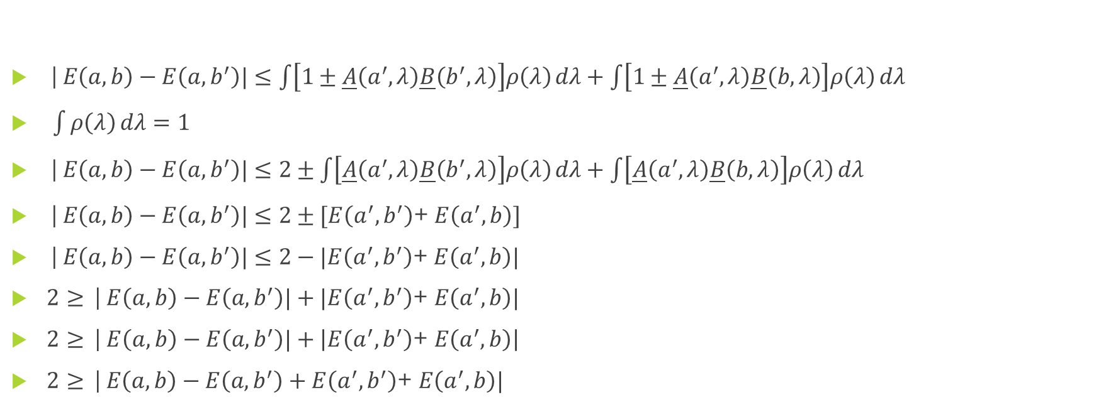
CHSH inequality
|$E\left(a,b\right)−E\left(a,b^{′}\right)|≤\int{\left[1±\underline{A}\left(a^{′},λ\right)\underline{B}\left(b^{′},λ\right)\right]ρ\left(λ\right)}dλ+\int{\left[1±\underline{A}\left(a^{′},λ\right)\underline{B}\left(b,λ\right)\right]ρ\left(λ\right)}dλ$
$\int{ρ\left(λ\right)}dλ=1$
|$E\left(a,b\right)−E\left(a,b^{′}\right)|≤2±\int{\left[\underline{A}\left(a^{′},λ\right)\underline{B}\left(b^{′},λ\right)\right]ρ\left(λ\right)}dλ+\int{\left[\underline{A}\left(a^{′},λ\right)\underline{B}\left(b,λ\right)\right]ρ\left(λ\right)}dλ$
|$E\left(a,b\right)−E\left(a,b^{′}\right)|≤2±[E\left(a^{′},b^{′}\right)$+ $E\left(a^{′},b\right)]$
|$E\left(a,b\right)−E\left(a,b^{′}\right)|≤2−|E\left(a^{′},b^{′}\right)$+ $E\left(a^{′},b\right)|$
$2≥$ |$E\left(a,b\right)−E\left(a,b^{′}\right)|+|E\left(a^{′},b^{′}\right)\text{+ }E\left(a^{′},b\right)|$
$2≥$ |$E\left(a,b\right)−E\left(a,b^{′}\right)|+\left|E\left(a^{′},b^{′}\right)\text{+ }E\left(a^{′},b\right)\right|$
$2≥$ $\text{|}E\left(a,b\right)−E\left(a,b^{′}\right)+E\left(a^{′},b^{′}\right)\text{+ }E\left(a^{′},b\right)|$

Slide 33
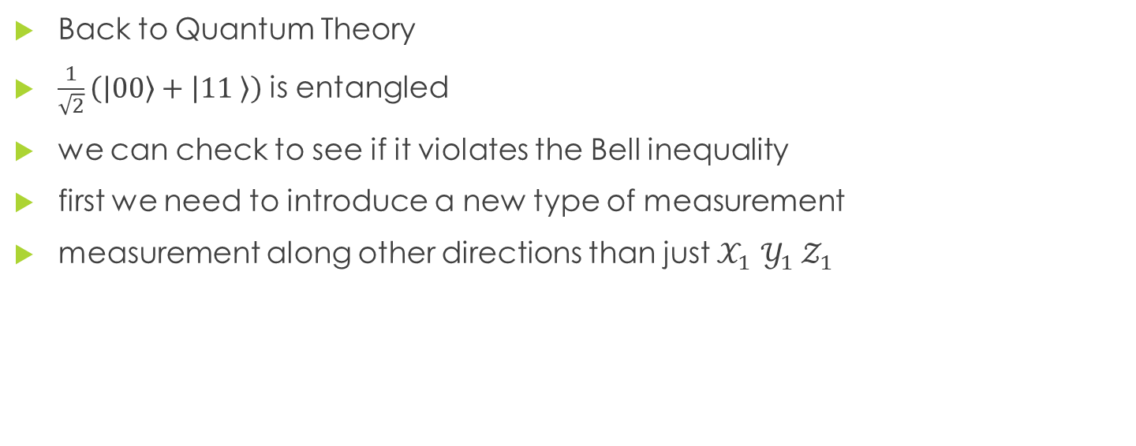
Checking the Bell Inequality
Back to Quantum Theory
$\frac{1}{\sqrt{2}}\left(\left|00\right\rangle +\left|11 \right\rangle \right)$ is entangled
we can check to see if it violates the Bell inequality
first we need to introduce a new type of measurement
measurement along other directions than just $𝒳_{1}$ ${𝒴_{1} 𝒵}_{1}$

Slide 34



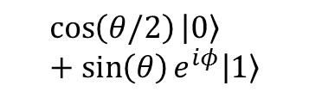

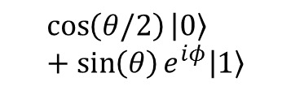







Measurement along Vector
$$\left|0\right\rangle$$
$$\left|0\right\rangle$$
measurement along a direction in the X-Z plane
${ 𝒵}_{1}=|0〉〈0|−|1〉〈1|$
$𝒳_{1}$ $=|1〉〈0|+|0〉〈1|$
$A_{1}\left(a\right)=\sin\left(a\right)𝒳_{1}+cos⁡(a){ 𝒵}_{1}$
$$\cos\left(θ/2\right)\left|0\right\rangle +\sin\left(θ\right)e^{iφ}|1〉$$
$$\cos\left(θ/2\right)\left|0\right\rangle +\sin\left(θ\right)e^{iφ}|1〉$$
$$θ$$
$$θ$$
$$φ$$
$$φ$$
$\frac{1}{\sqrt{2}} (\left|0\right\rangle +\left|1\right\rangle$)
$\frac{1}{\sqrt{2}} (\left|0\right\rangle +\left|1\right\rangle$)
$$\left|1\right\rangle$$
$$\left|1\right\rangle$$

Slide 35
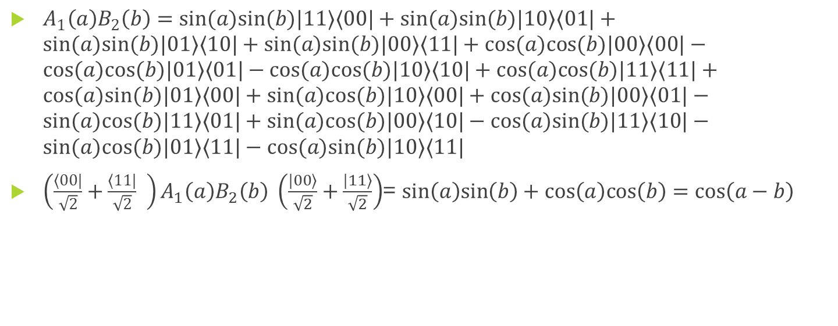
Expected Value Along Vectors
$A_{1}\left(a\right)B_{2}\left(b\right)=sin(a)sin(b)|11〉〈00|+sin(a)sin(b)|10〉〈01|+sin(a)sin(b)|01〉〈10|+sin(a)sin(b)|00〉〈11|+cos(a)cos(b)|00〉〈00|−cos(a)cos(b)|01〉〈01|−cos(a)cos(b)|10〉〈10|+cos(a)cos(b)|11〉〈11|+cos(a)sin(b)|01〉〈00|+sin(a)cos(b)|10〉〈00|+cos(a)sin(b)|00〉〈01|−sin(a)cos(b)|11〉〈01|+sin(a)cos(b)|00〉〈10|−cos(a)sin(b)|11〉〈10|−sin(a)cos(b)|01〉〈11|−cos(a)sin(b)|10〉〈11|$
${\left(\frac{〈00|}{\sqrt{2}}+\frac{〈11|}{\sqrt{2}} \right)A}_{1}\left(a\right)B_{2}\left(b\right) \left(\frac{|00〉}{\sqrt{2}}+\frac{|11〉}{\sqrt{2}}\right)$= $sin\left(a\right)sin\left(b\right)+cos\left(a\right)cos\left(b\right)=\cos\left(a−b\right)$

Slide 36
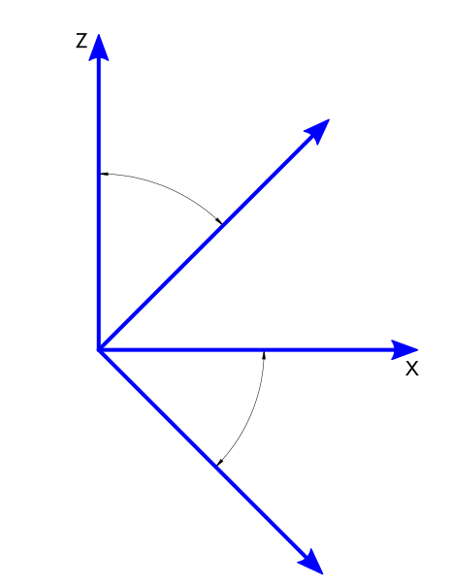

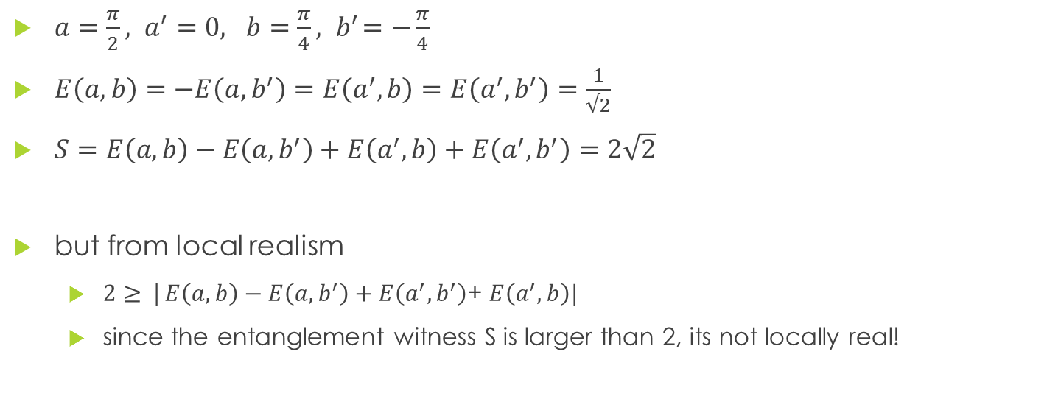





Bell-CHSH quantum mechanics
$a=\frac{π}{2}, a^{′}=0, b=\frac{π}{4}, { b}^{′}=−\frac{π}{4}$
$E\left(a,b\right)=$ $−E\left(a,b^{′}\right)=E\left(a^{′},b\right)=E\left(a^{′},b^{′}\right)=\frac{1}{√2}$
$S=E\left(a,b\right)−E\left(a,b^{′}\right)+E\left(a^{′},b\right)+E\left(a^{′},b^{′}\right)=2\sqrt{2}$
but from local realism
$2≥$ $\text{|}E\left(a,b\right)−E\left(a,b^{′}\right)+E\left(a^{′},b^{′}\right)\text{+ }E\left(a^{′},b\right)|$
since the entanglement witness S is larger than 2, its not locally real!
$$a$$
$$\frac{π}{4}$$
$$b$$
$$a^{′}$$
$$\frac{π}{4}$$
$${ b}^{′}$$

Slide 37
What we learned
Entanglement can be verified with Bell states using statistics
Entanglement can be verified with GHZ states – single shot measurements
All the quantum theory to describe multi-qubit states
Multi-qubit parity measurements – the basis for quantum error correction

Slide 38
Next Time
Explore algorithms which use entanglement for exponential speedup
Deutsch-Josza
Shor
Quantum Chemistry
Quantum Algorithm for Linear Systems of Equations (Harrow, Hassidim, and Lloyd)

Slide 39
IBM
End of Entanglement and its Verification

